Slide 1
Toppings
Your CSS Side-Quest :)

Slide 2
Set up a basic website
Skip to this slide if you’ve done this already
Useful if this is your first time doing it!

Slide 3
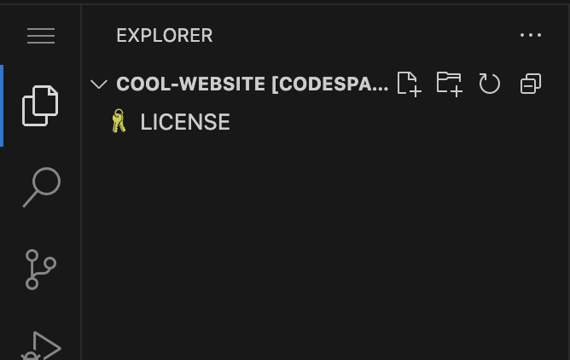
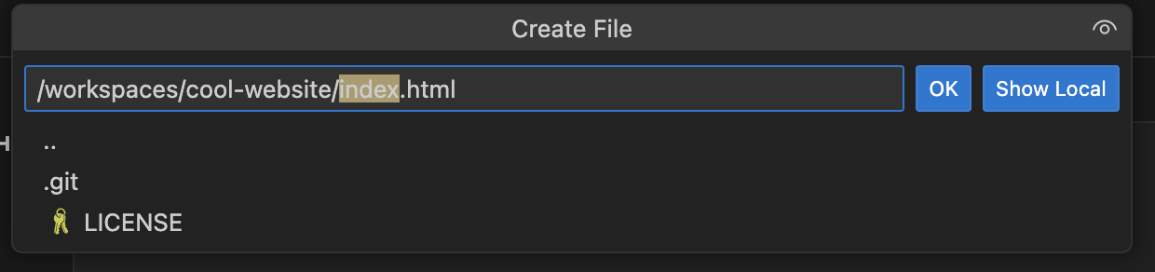


CREATE YOUR HTML FILE
Open VS code
Click the + button at the top to create a new file.
Name the file index.html.
HTML (Hypertext Markup Language) is the basis of every website; it’s used to display content on the web!

Slide 4
STEP 2: Start coding!

Slide 5
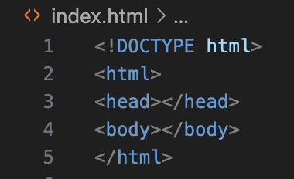
OUR FIRST CODE
HTML uses tags to organise content. Tags surround the content it’s describing. For example, <html></html> is a tag that surrounds the whole html file. Inside the html tags, we have the:
<head></head> tag – holds data about the page which it tells the browser. None of the information in the <head> tags show anything to the screen.
<body></body> tag – holds all of the content that is displayed
<!DOCTYPE html> - tells the browser what version of HTML to expect. HTML is constantly updating, so there are multiple versions. In our case, we are going to use HTML5, the latest version.
Now you know what this code means, you can copy it out into your codespace!

Slide 6
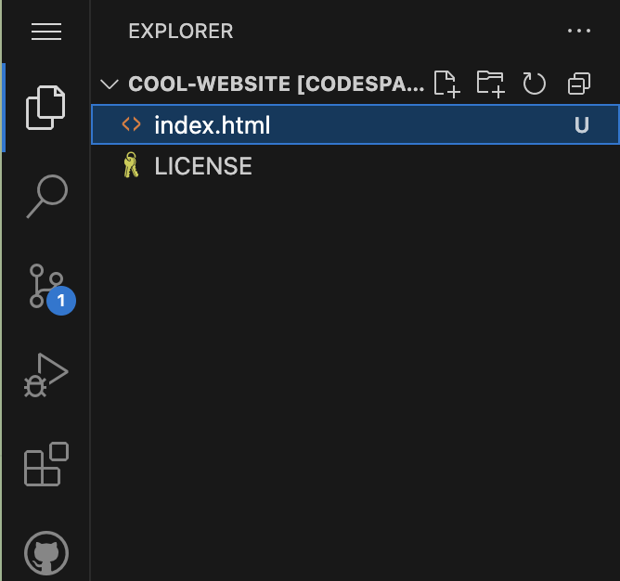

PREVIEW YOUR SITE
Let’s preview our site!
Click on the extensions tab

Slide 7
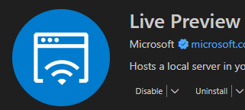
PREVIEW YOUR SITE
Search for live preview and click install (you might’ve already done this!)

Slide 8

PREVIEW YOUR SITE
Go back to your files

Slide 9
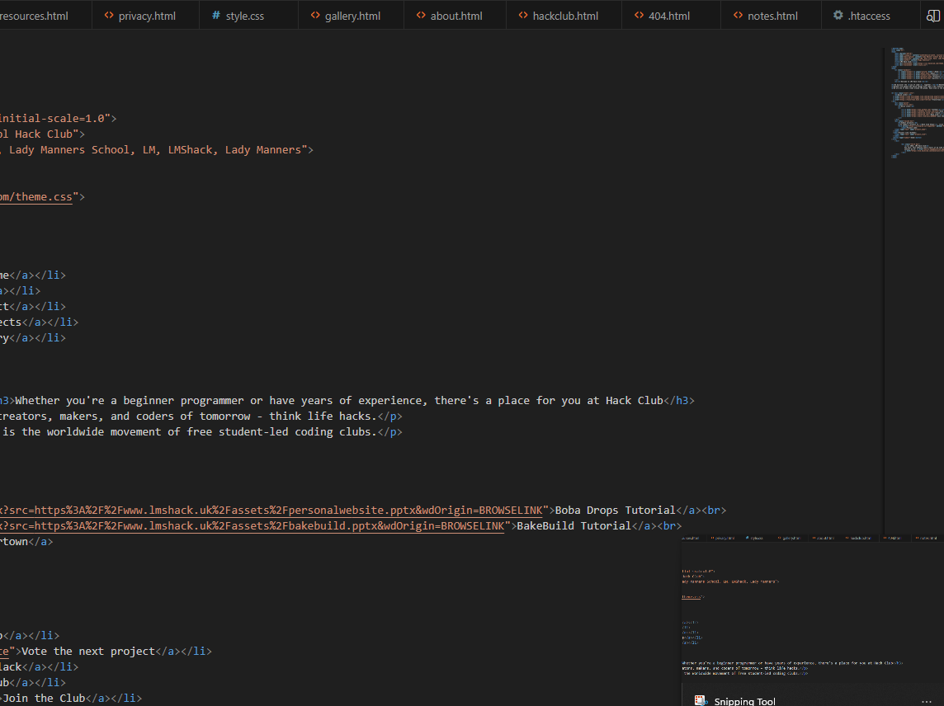

PREVIEW YOUR SITE
Click this button
A new tab should open with your (blank) page!

Slide 10
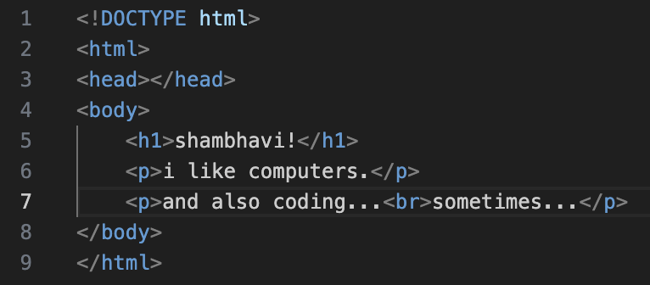
ADDING CONTENT - text
Let’s add some content!
We’ll use <h1></h1> tags for our heading. h1 means heading 1; it goes all the way up to h6. h1 is the largest and h6 is the smallest.
We’ll also use <p></p>. These tags for paragraphs
Remember to add your content inside the body tags!
N.B: if you want line breaks, you can either use separate <p></p> tags for each paragraph, or use a single <br> tag. The <br> tag doesn’t have a closing tag; there’s no </br>. This is because <br> doesn’t contain anything. We call these void elements. (fancy word alert)

Slide 11

ADDING CONTENT - images
We add an image by using the <img> tag. Once again, this is a void element, so there’s no closing tag.
The image tag has an attribute called src, which will hold the source URL of the image you want to display.
For example, if I wanted to display a picture of Orpheus with URL https://github.com/hackclub/dinosaurs/raw/main/smart_dinosaur_docs.png , I’d add
<img src="https://github.com/hackclub/dinosaurs/raw/main/smart_dinosaur_docs.png">

Slide 12
STEP 3: Set up the CSS file

Slide 13
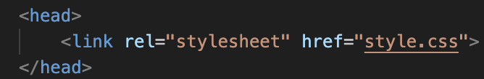
LINK THE CSS FILE
Create a new file and call it style.css. CSS is how we can personalise our website! It changes how your content looks (e.g. changing the colours, layout, or fonts)
We need to tell our HTML file to use our style.css file, using <link rel="stylesheet" href="style.css"> Link is a tag that’s used for specifying another file’s relationship with the HTML file! So rel=“stylesheet” tells the HTML that we want to use style.css as instructions on how to personalise our page.
We would put this inside the head tags, because it’s something that we don’t want displayed; it’s just something we tell the browser.
N.B. You might have noticed, link is another void element.

Slide 14
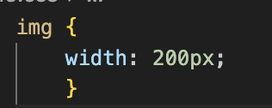
ADD TO THE CSS FILE
Let’s fill in our CSS file. Go to style.css and type in:
The “img” selector (fancy word alert) tells the browser that we’re describing every <img> element (every image) in the HTML file.
The rules inside {} control their appearance. In this example, we're making every image 200 pixels wide, by setting the “width” attribute (another fancy word) to 200px. P. S. if your code starts throwing errors at you, you might have forgotten the “;” at the end of line 2!

Slide 15
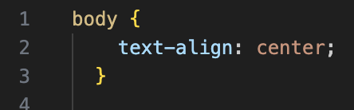
ADD TO THE CSS FILE
Next, let’s centre align everything!
We’ll use the selector “body” since that contains everything that’s displayed.
We can set the attribute “text-align” to center

Slide 16
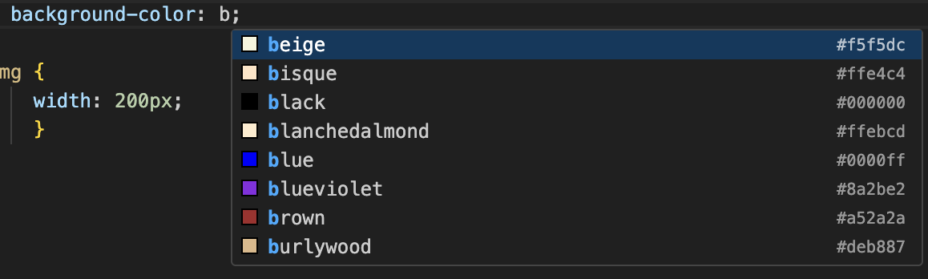
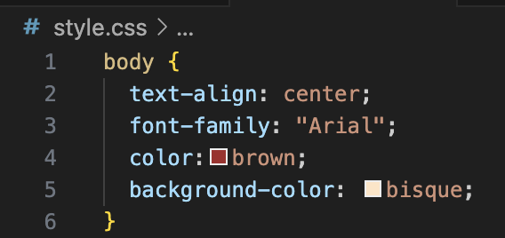

ADD TO THE CSS FILE
We can change the font by using the attribute “font-family”. Check w3schools for reliable fonts to use.
Change the text colour by using the attribute color (with no “u”). You can either use a hex code, beginning with #, or start typing and choose one of the suggestions!
Change the background colour by using the attribute background-color.
Remember to check the demo!

Slide 17
STEP 4: Publish your site

Slide 18
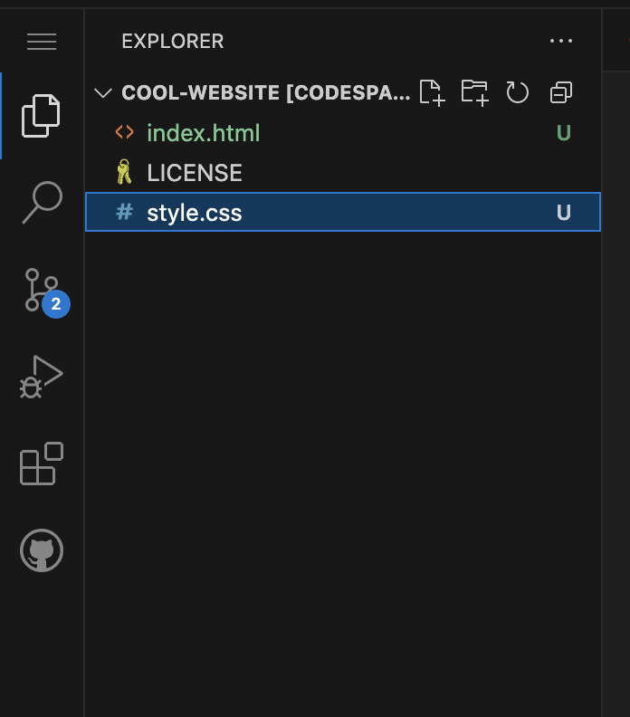

COMMIT
Click on the Source Control button on the left

Slide 19
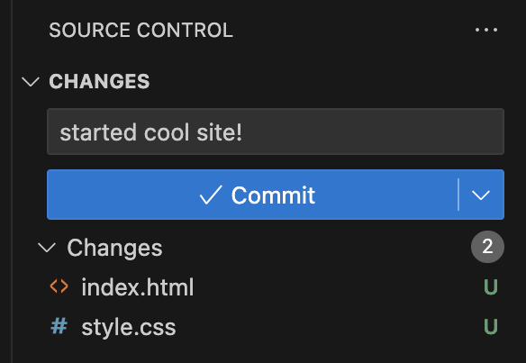
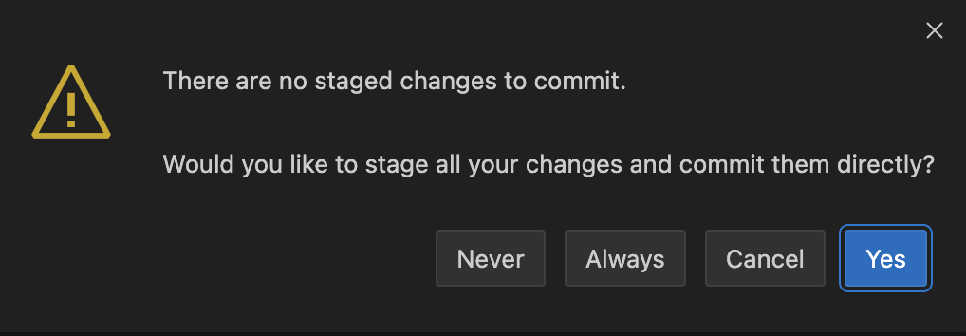
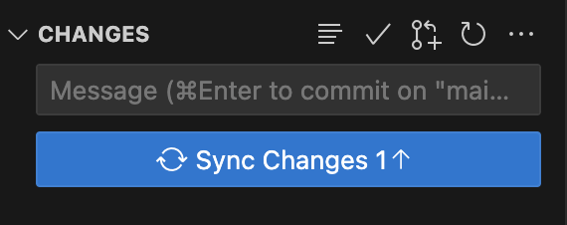
COMMIT
Type in a commit message and commit
Press Always on the popup
Press Sync Changes

Slide 20
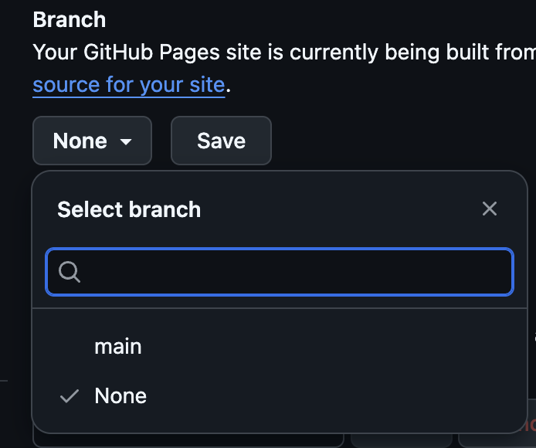


GITHUB PAGES
Go to your project repo.
Go into your project settings at the top. Scroll all the way down and change the visibility to public. This will allow you to deploy the website using GitHub Pages.
Go to Pages on the left-hand side, under Code and Automation.
Under Branch, select main, and press save.
Give it a few minutes to deploy, then go to USERNAME.github.io/REPO-NAME

Slide 21
Focus on CSS!
Go back to setting up

Slide 22
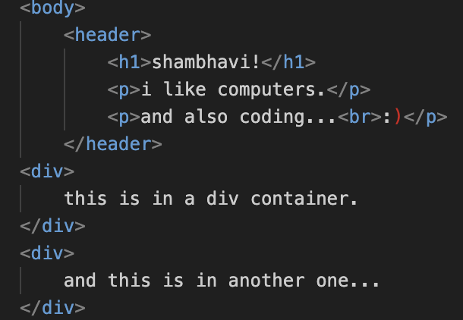
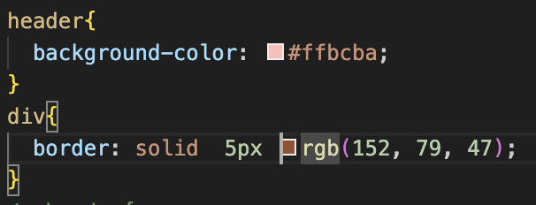
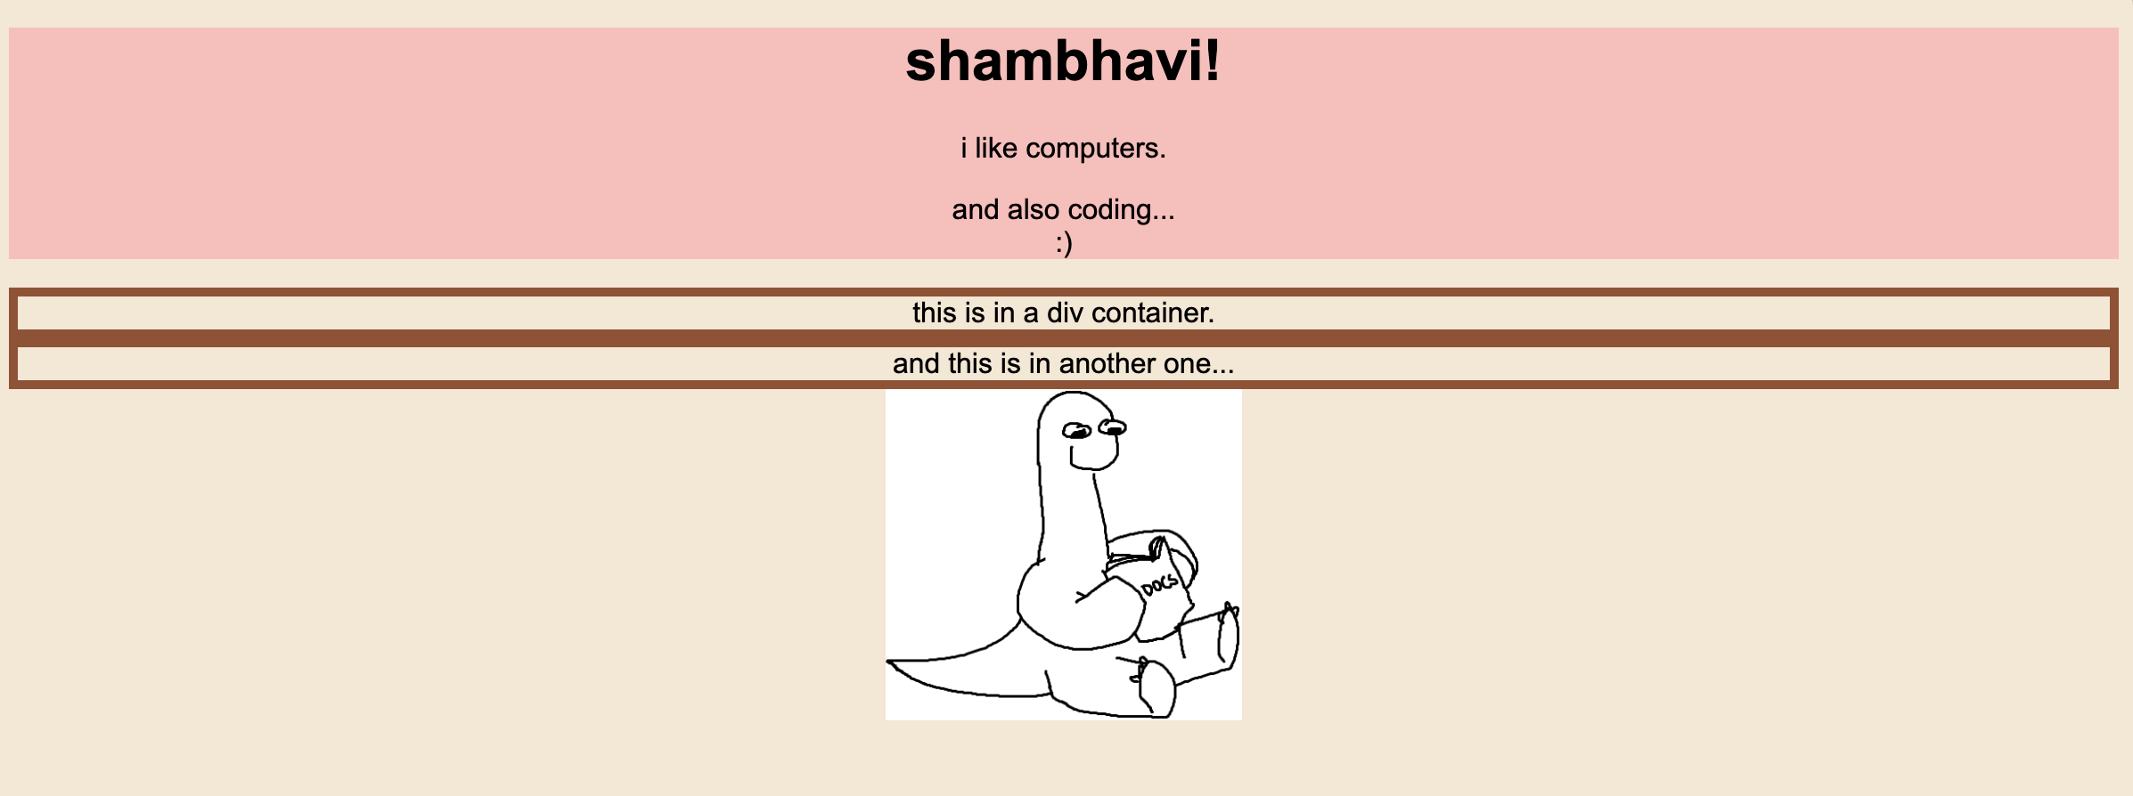
Containers
When we have loads of content on our page, we need to put our stuff into little boxes to help organise and style our content! These boxes are containers.
We can have different types of containers; here are some of the main ones:
<header> - a container at the top of our page
<footer> - a container at the bottom of our page
<div> - a container that can be used for anything! It can be anywhere in your page
This means you can style different parts of the page differently.
Play around with the border attribute; you can have different patterns, thicknesses, and colours.

Slide 23
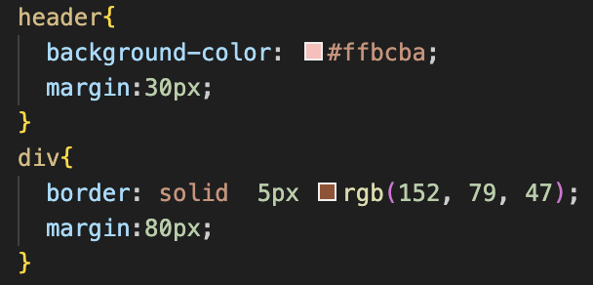
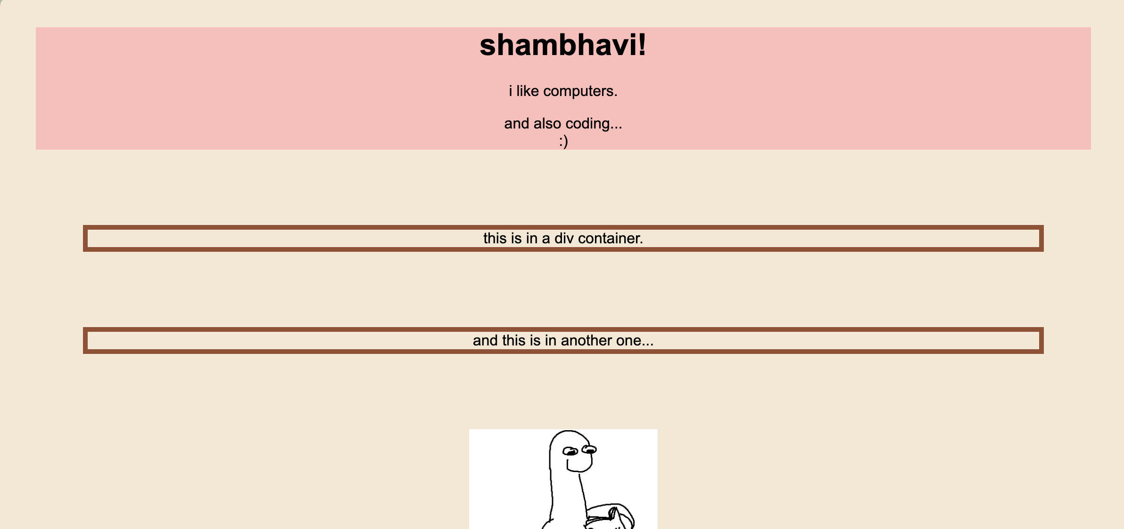

Margins
Right now, everything stretches all the way out to the edge of the screen… which might not be the look you’re going for. Let’s look at margins!
Margins create space around an element.
You can put margins around individual elements or containers (including the whole body).

Slide 24
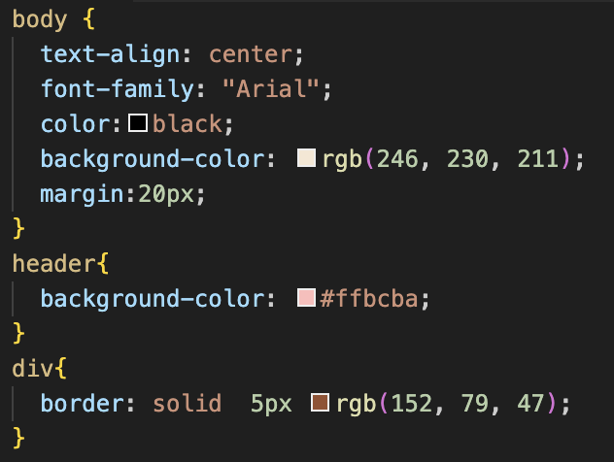
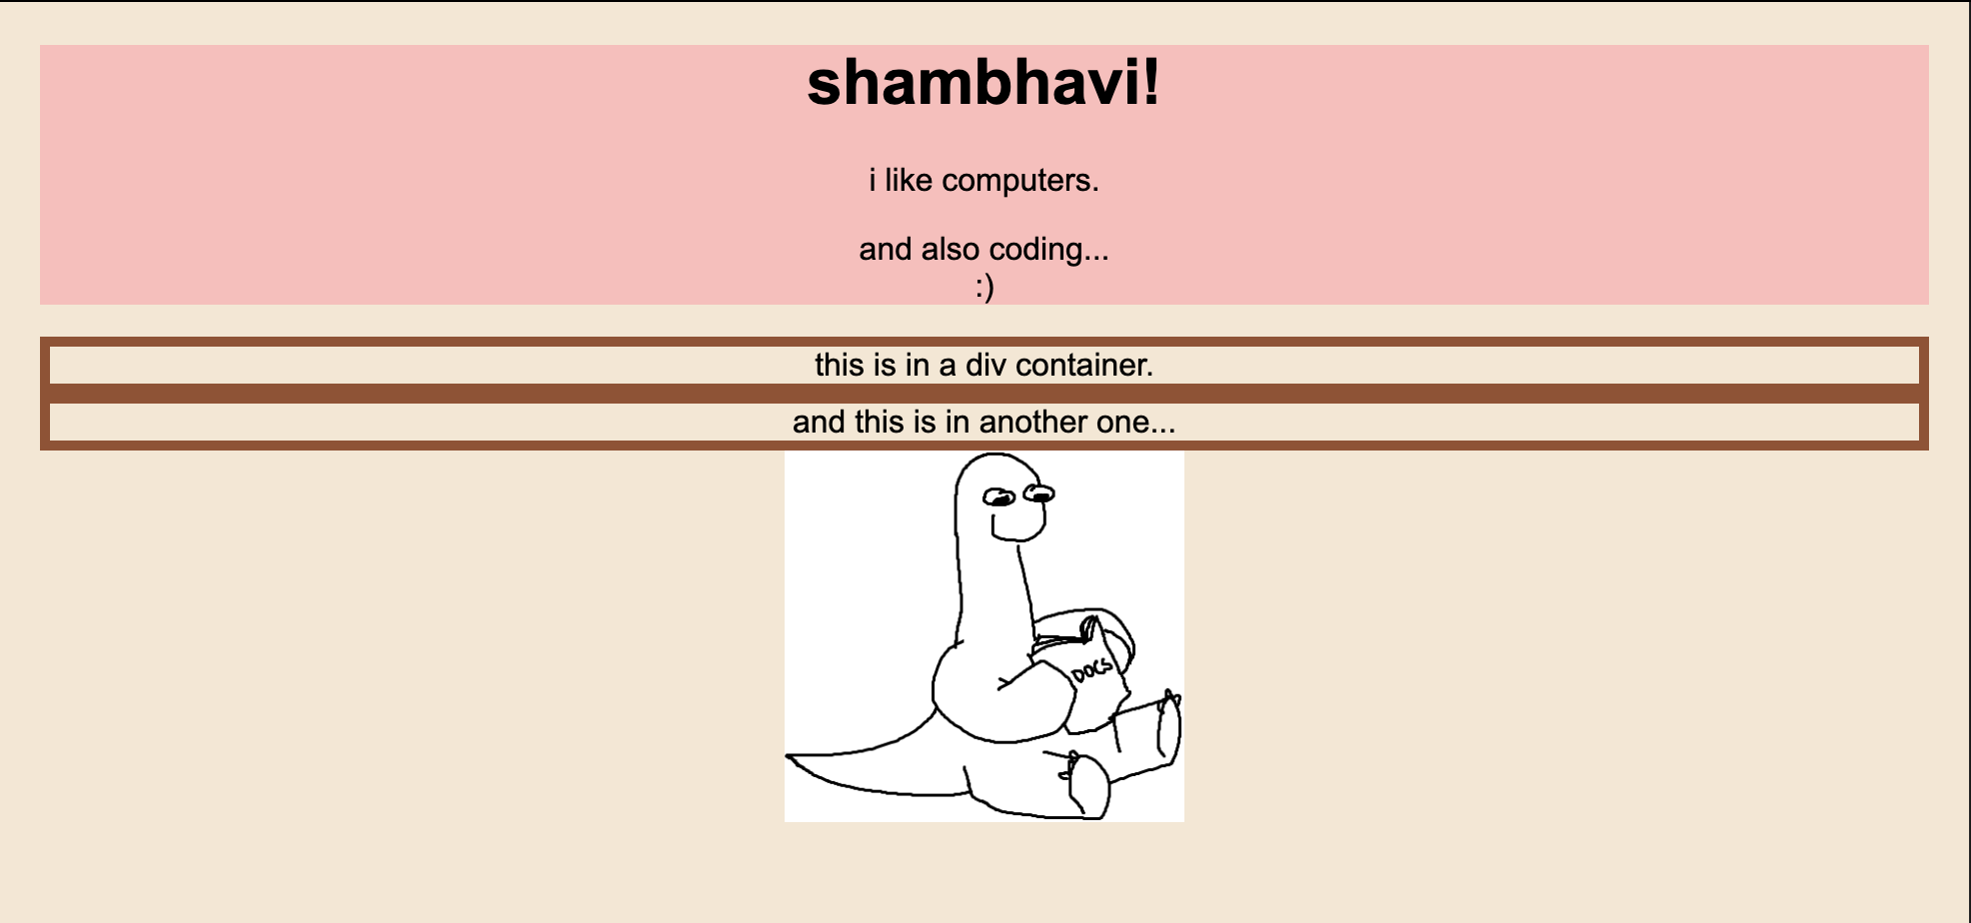
Margins
This is what margins around the whole body look like!
The <p> tag has an automatic 16px margin
If you set the left and right margins to auto, it will centre itself in its container!

Slide 25
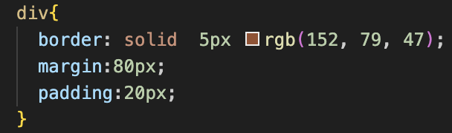
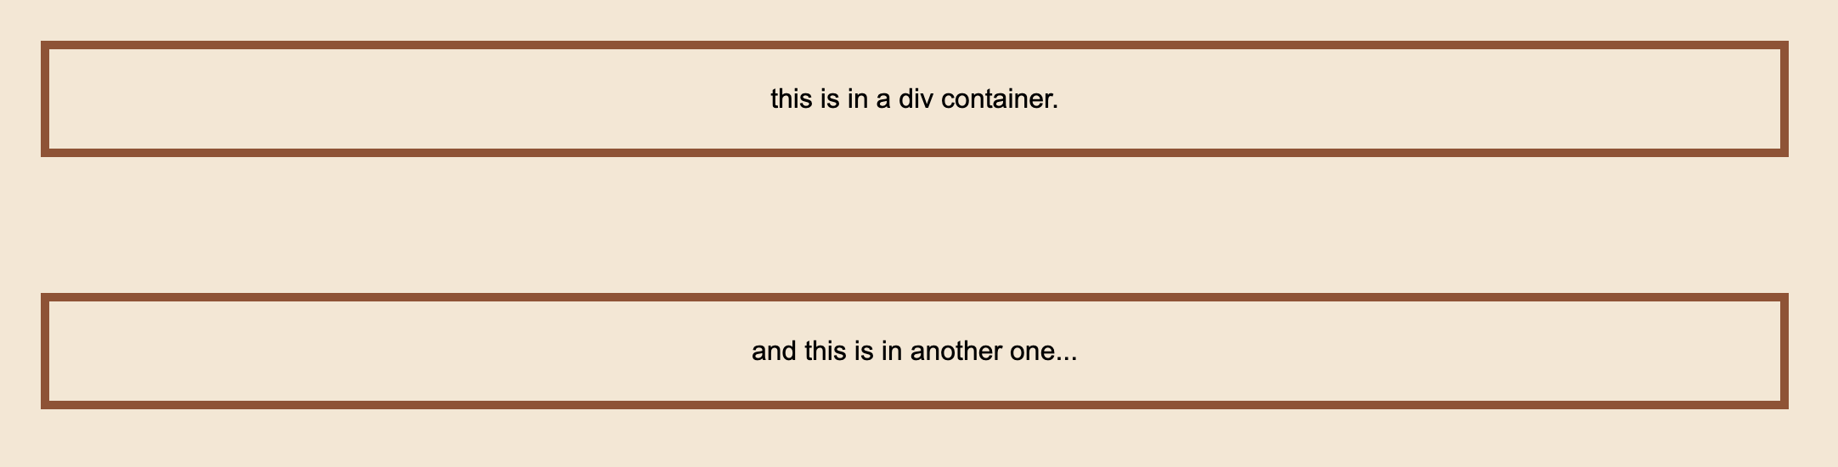
Padding
Padding creates space between the content and the border of an element
20px
20px
20px
20px

Slide 26
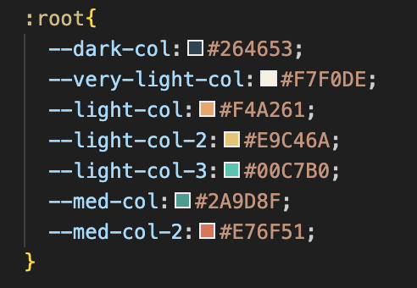
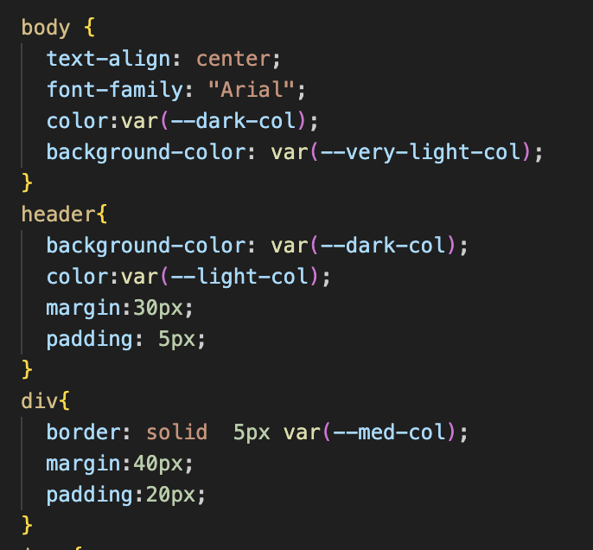
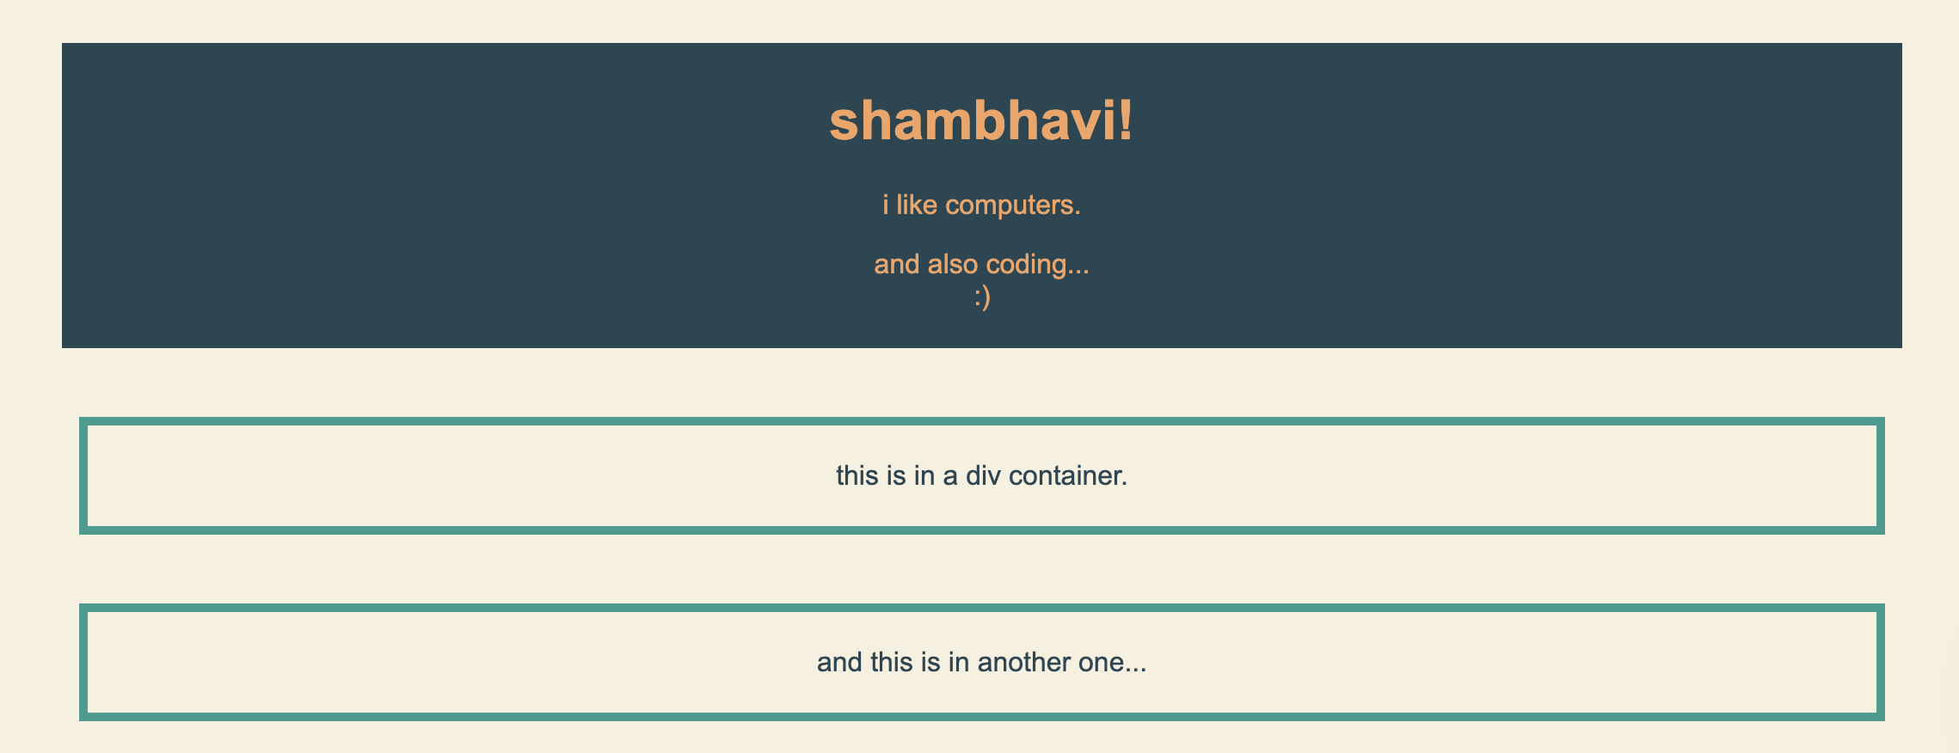
Variables
Tired of manually updating every single hex code just to change one colour?
You can set variables to define a value and use it multiple times throughout the page
I’ve shown it here with colours, but you can use this with numerical values as well!

Slide 27
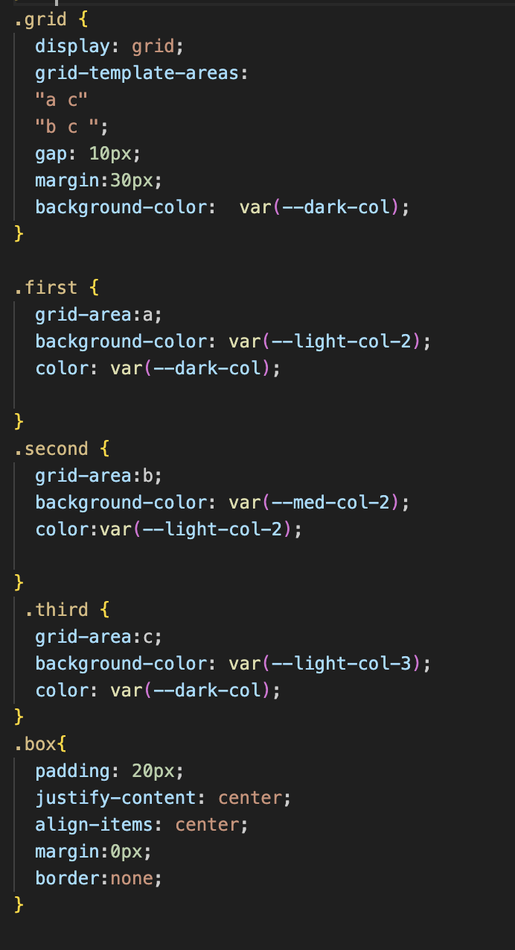
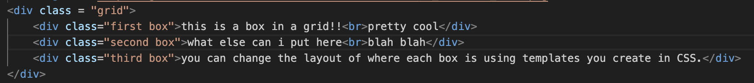
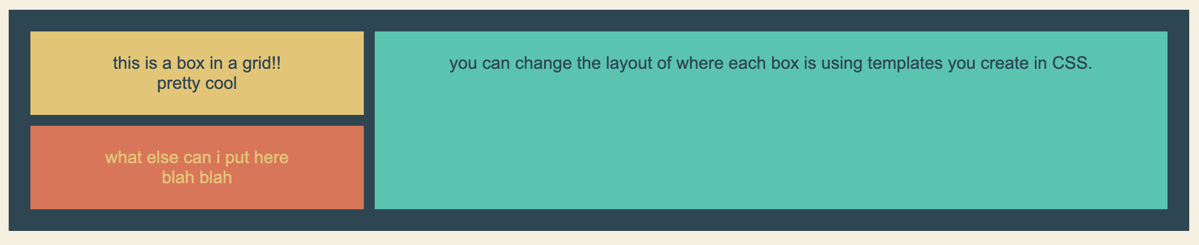
Grids
Grids are a great way to create new layouts
.grid {…} styles the container that holds the boxes
display: grid; turns container into grid
grid-template-areas…
Defines a layout grid:
Top row: area "a" on the left, "c" on the right
Bottom row: area "b" on the left, "c" still on the right. This means "c" spans two rows.
gap: 10px; Adds 10px of space between each grid item.

Slide 28
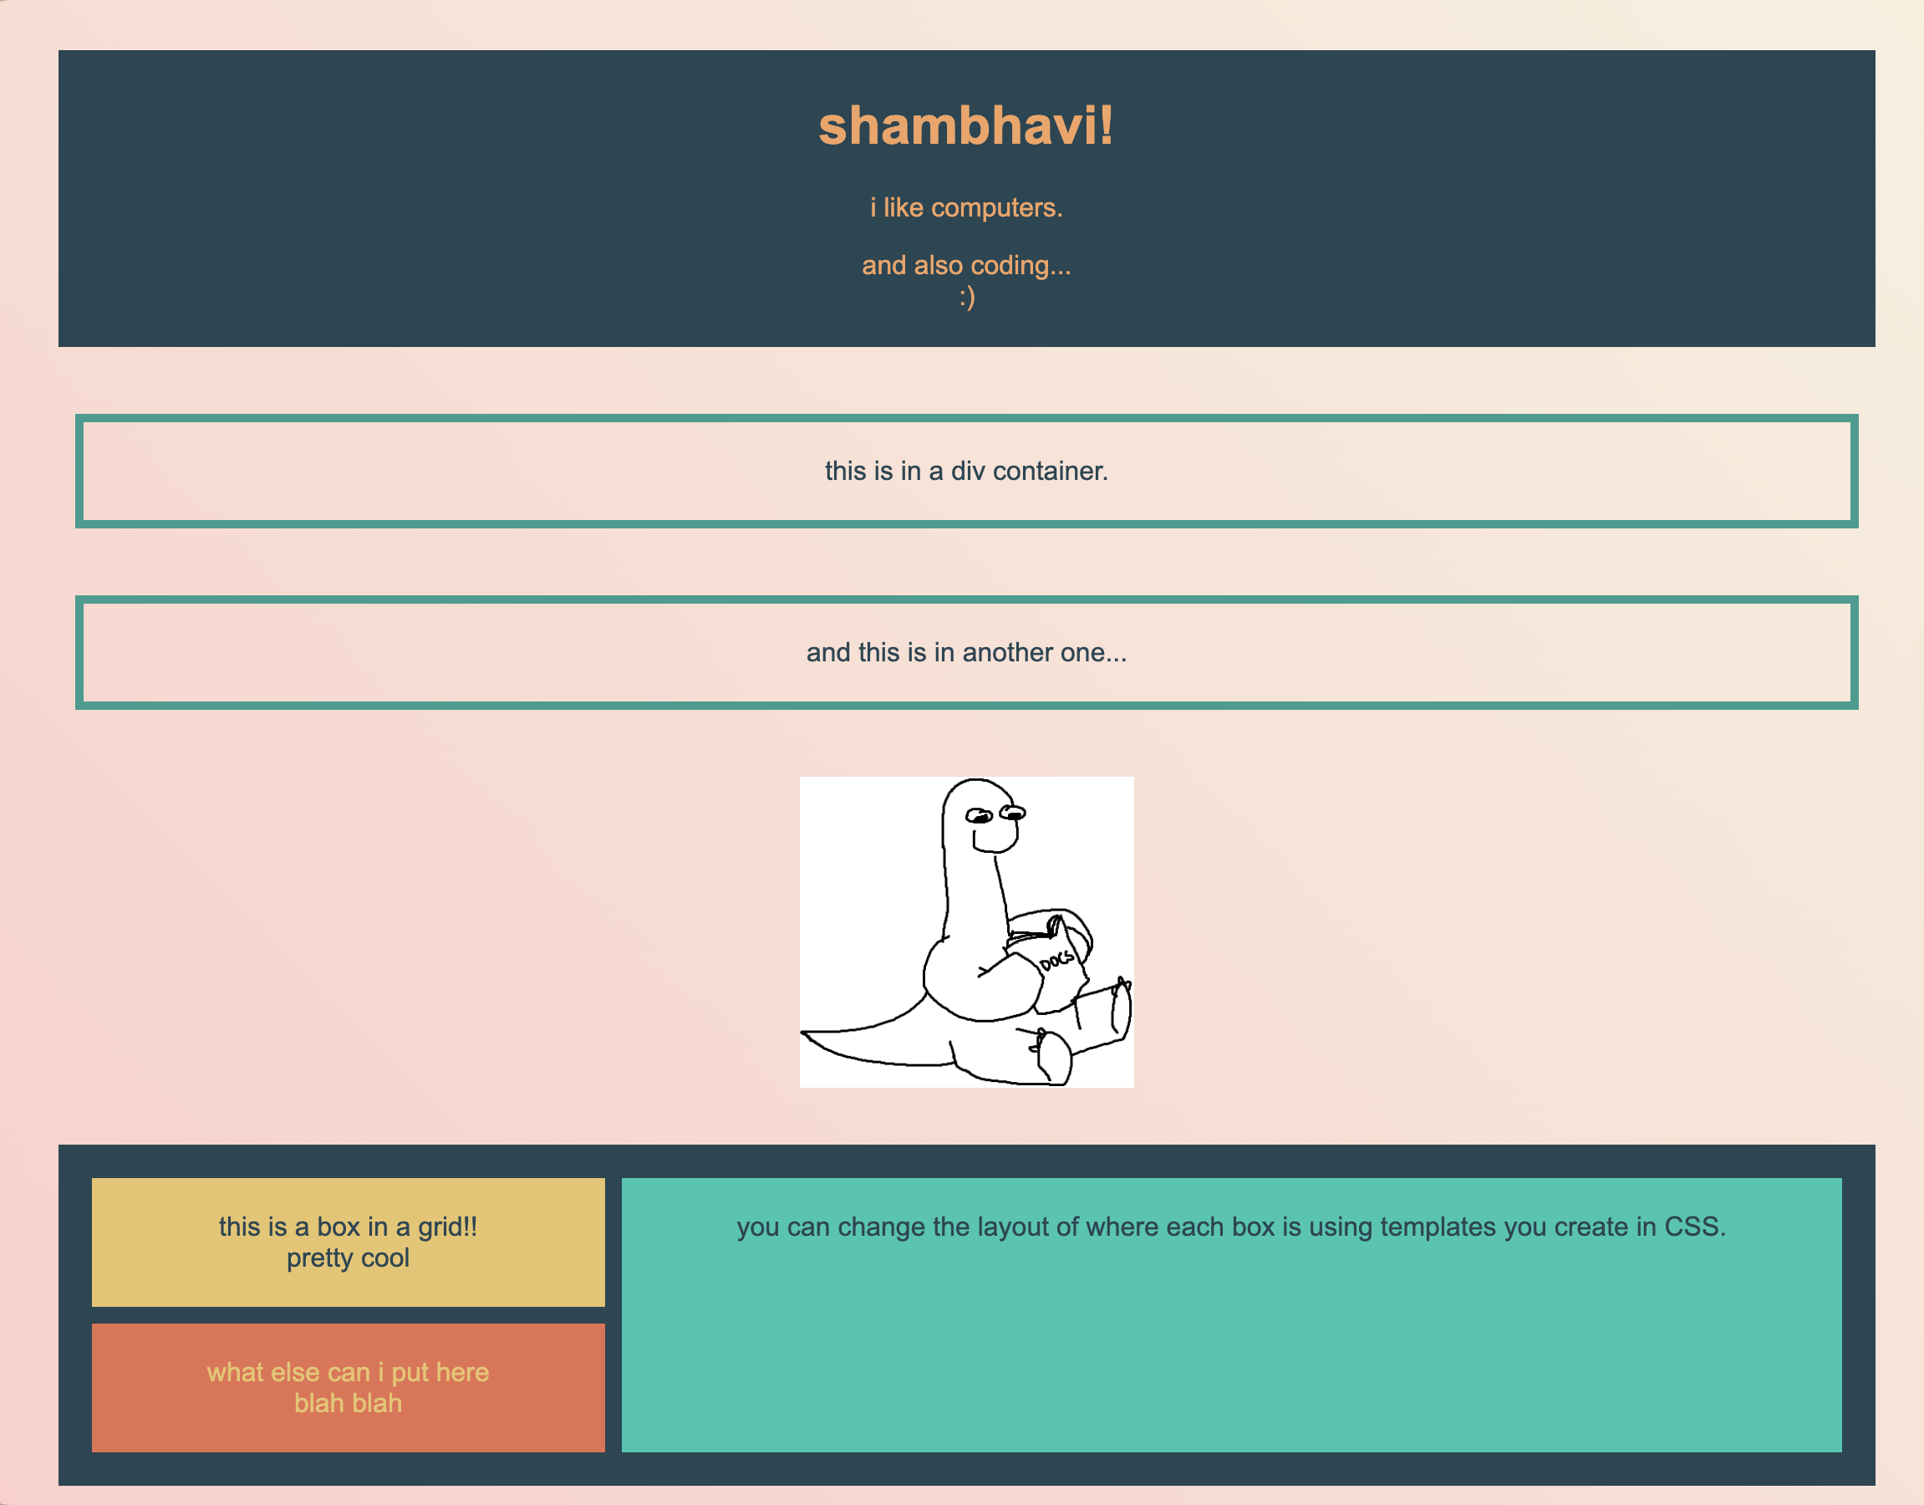
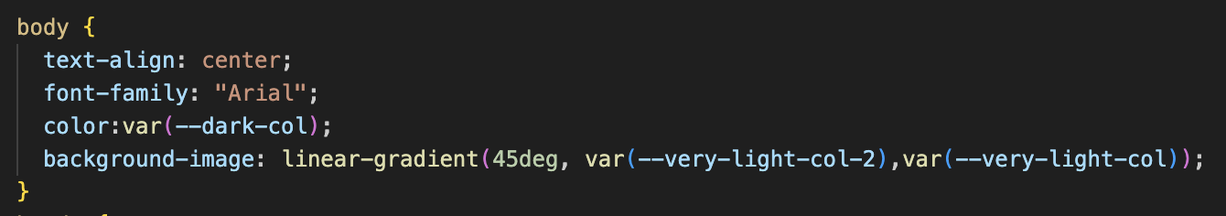
Gradient backgrounds
linear-gradient(…) – a type of gradient, a straight line blending from one colour to another.
Play around with radial-gradient and conic-gradient!
45deg – angle of the gradient, from the top right corner to the bottom left.
NB: You can do more than 2 colours

Slide 29
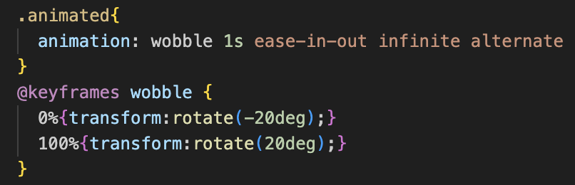
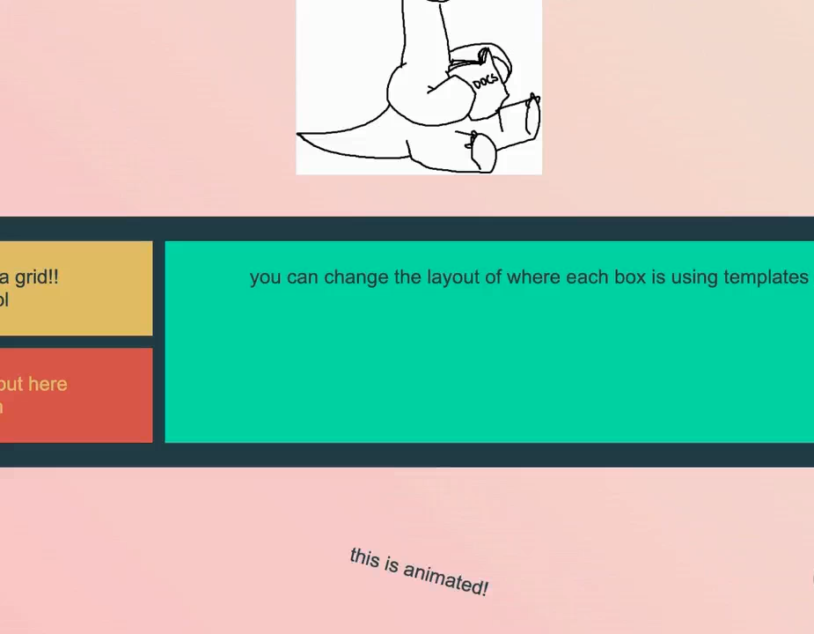
Animations
@keyframes – lets you set what you want an element to look like at different points in the animation.
0% is 0% of the way through the animation, the start. 100% is the end of the animation. You should set these two first, then experiment with other %s!
transform: rotate(-20deg) means rotate the element 20 degrees anticlockwise. (20deg) is clockwise
This is part of the transform property, which can also move (translate) and resize (scale)

Slide 30
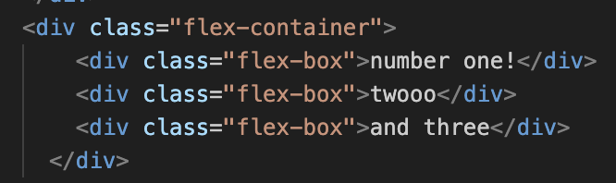
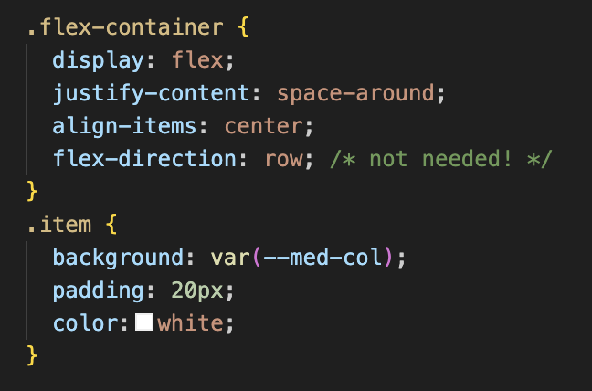

Flexboxes (the basics)
Flexbox helps you align and space elements easily!
Flex-direction is set to row by default, lining things up from left to right, but try out row-reverse, column, and column-reverse.
Justify content controls how items are spaced along the flex-direction. Currently it sets the spacing horizontally, because the flex-direction is row. space-around gives equal space on both sides of each item.
Align-items controls how items are aligned on the cross axis (perpendicular to the flex-direction). You can use values like flex-start, center, or stretch!
Go to flexboxfroggy.com to play about with flexboxes more :)

Slide 31
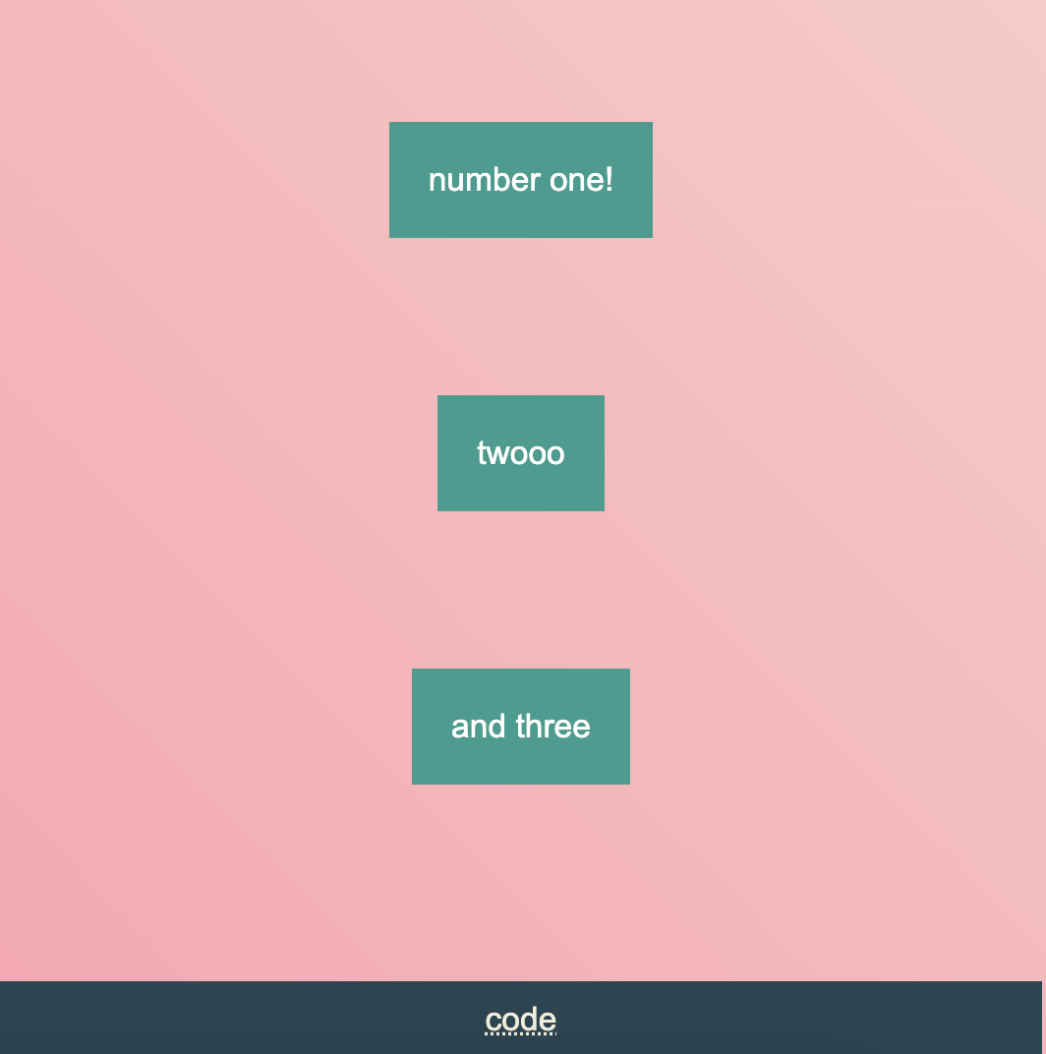
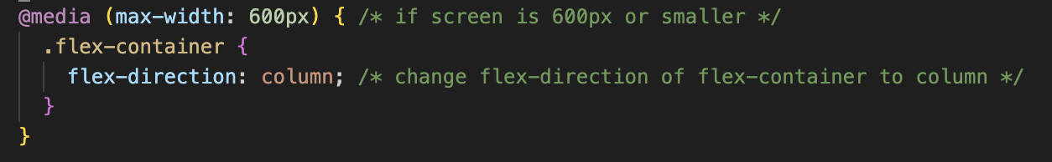
Responsive design
You can adapt your site to different screen sizes in different ways!
One of the simpler ways to do this is to use relative units, such as rem, vw (view widths), and vh (view height). rem is commonly used for font sizes, while the others are used for widths and heights. vw and vh are %s on the screen widths and heights
You can also use media queries to alter some of the properties depending on the screen size, shown below!

Slide 32
And that’s it! Hope you had fun :D

